Slide 1

Houston Tech Fest
May 5 2018

Slide 2
Give your App/Web Site Superpowers with Cognitive Services
Shawn Weisfeld
Cloud Solution Architect
Microsoft

Slide 3

About Me
Shawn Weisfeld
Cloud Solution Architect
Microsoft – One Commercial Partner Technical Team
sweisfel@microsoft.com
Austin, TX

Slide 4
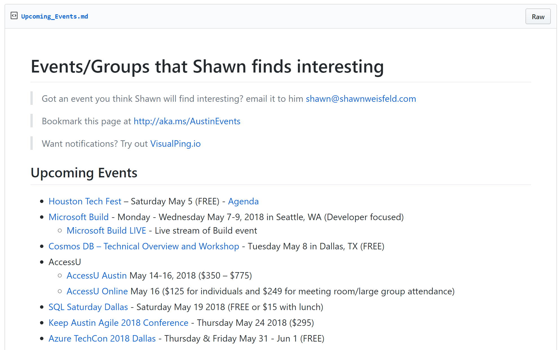
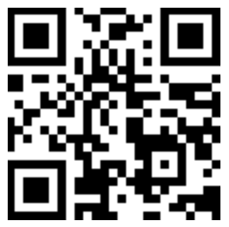
Regional Events
https://aka.ms/AustinEvents

Slide 5


Watch User Group presentations for FREE online! We now have over 750 presentations online
Miss a User Group meeting?
Forget something that you learned?
Want to see content from a User Group not in your area?
Want to share with a buddy?
Presentations from the thought leaders on the topics you care about including:
Agile
Azure
C#
Entity Framework
HTML5
MVC
SQL
jQuery
and Much More!
We know you cannot make it to every session,
that is why we post them online for you!
New Content added all the time!
For new content announcements
@UserGroupTV
http://www.UserGroup.tv

Slide 6
Agenda
Why Cognitive Services?
What Services are Available?
How do I use them?

Slide 7
Why Cognitive Services?

Slide 8
Video: Helpicto & Uber

Slide 9

T H E JFK F I L E S
The truth is in there

Slide 10


Slide 11

messy room picture here

Slide 12

How do we do this?
Ingest
Enrich
Explore

Slide 13


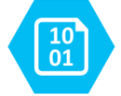

Ingest
Enrich
Explore
Cognitive skills
Data Feed
Search
Annotations
Cognitive Search Pattern

Slide 14

John F. Kennedy (JFK)
November 22, 1963
http://aka.ms/jfkfiles

Slide 15



Analyzing legal contracts
Understanding engineering plans
Extracting form information

Slide 16
What Services are Available?

Slide 17
Cognitive Services Directory
https://azure.microsoft.com/en-us/services/cognitive-services/directory/

Slide 18
How do I use them?

Slide 19
VI & Postman Demo
https://vi.microsoft.com
https://ww.getpostman.com

Slide 20
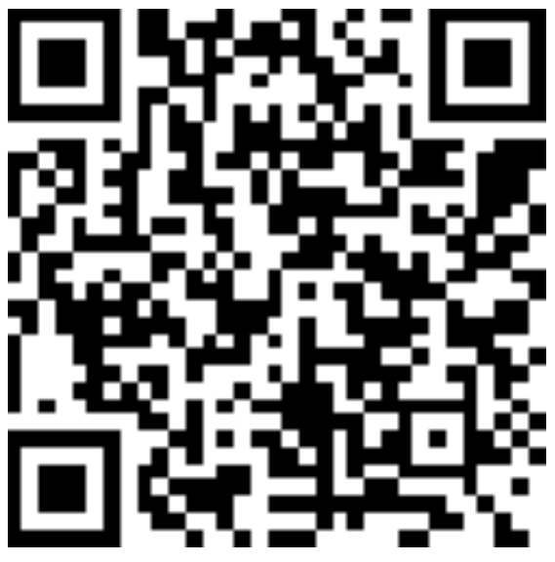
Thank you! Your Feedback is Important
Rate My Talk & Download Slides!
http://bit.ly/RateShawnsTalk
(case sensitive)
Contact Information
Email: sweisfel@microsoft.com
Blog: http://www.shawnweisfeld.com
Twitter: @shawnweisfeld

